Slide 1
THE TEAM
Multi Cloud Subscription & Cost Management Application
Software Product Management
Group AH – Assignment 2
1. MALLIDI AKHIL REDDY (2024TM93056)
2. CHITTAJALLU PREM GURUMUKH (2024TM93279)
3. MANAN PRAVINKUMAR PARMAR (2024TM93030)
4. PRAKASHA G (2024TM93260)
5. UDYAGIRI VENKATAGURU PRASAD (2022TM93653)

Slide 2
Product Idea The proposed product is an AI-powered cloud cost management app designed to automate resource management, optimize costs, and provide centralized control over multi-cloud subscriptions.
Assignment 1 - Summary
Automatic Resource Management: Uses AI to dynamically allocate and deallocate resources based on real-time usage and historical data.
Centralized Multi-Cloud Subscription Management: Provides a unified interface for managing subscriptions across multiple cloud platforms.
Real-Time Cost Monitoring and Alerts: Uses AI to detect anomalies and send alerts for unusual spending patterns.
AI-Driven Cost Optimization Recommendations: Offers suggestions to optimize cloud spending by identifying unused resources and recommending cheaper alternatives.
Budgeting and Forecasting Tools: Utilizes AI to forecast future cloud costs based on past trends and usage patterns.

Slide 3
Pain Points The key pain points addressed by the AI-powered cloud cost management app include:
Assignment 1 - Summary
Over-Provisioning of Resources: Organizations often allocate more cloud resources than necessary, leading to increased costs.
Lack of Visibility into Cloud Usage: Without a centralized view, organizations struggle to monitor and manage cloud usage effectively.
Difficulty in Managing Multiple Cloud Subscriptions: Managing subscriptions across different cloud platforms can be complex and time-consuming.
Unpredictable Cloud Costs: Fluctuations in usage and varying pricing models can make it challenging to predict and control cloud expenses.

Slide 4
Customer Segment - Where it Will Be Used The primary customer segments for the proposed AI-powered cloud cost management app include:
Assignment 1 - Summary
Medium to Large Enterprises: These organizations use multiple cloud platforms like AWS, Azure, and Google Cloud and often struggle with managing costs across these platforms.
Example: Netflix relies heavily on cloud services to stream content globally. Managing the cost across multiple regions and services is complex, and an AI-powered solution can help optimize these costs dynamically.
IT Departments and Cloud Operations Teams: Individuals responsible for managing cloud resources and budgeting within organizations will benefit directly from using this app.
Example: Adobe has multiple cloud-based services such as Creative Cloud and Document Cloud. Their IT teams need tools that can provide visibility into usage and optimize resource allocation.
Cloud Service Resellers and Managed Service Providers (MSPs): These companies manage cloud services on behalf of their clients and require tools to optimize costs and provide value-added services.
Example: Rackspace Technology is a managed cloud computing company that helps businesses manage their cloud infrastructure across various platforms. Cost management tools are critical for them to optimize costs for their clients.

Slide 5
Target Market The target market for the AI-powered cloud cost management app includes:
Assignment 1 - Summary
Large Enterprises and Corporations: These organizations have complex cloud environments with multiple subscriptions and significant cloud spending.
Example: General Electric (GE) has multiple divisions using cloud services for different applications, making cost management a complex task. AI-driven insights could streamline this process.
Small to Medium Enterprises (SMEs): SMEs with growing cloud needs and a focus on cost control will also find value in the app.
Example: Slack started as an SME and used multiple cloud services for its operations. Efficient cost management was crucial for maintaining profitability during its growth phase.
Cloud Service Resellers and MSPs: Companies offering cloud services to other businesses and looking to optimize cloud costs for their clients.
Example: Accenture offers cloud management services to various clients and could benefit from tools that provide cost transparency and optimization capabilities.

Slide 6
Product Opportunity
Assignment 1 - Summary
Value proposition
Cost Efficiency: Identify underused resources and suggest more cost-effective pricing solutions to optimize cloud spending.
Centralized Management: Monitors and manages cloud subscriptions and costs across multiple cloud providers in one centralized dashboard.
AI powered cost Optimization Recommendations: AI powered historical data and forecasts future costs to inform resource allocation decisions.
Improved Efficiency: It automates routine tasks, such as tracking costs, managing budgets, and renewing subscriptions.

Slide 7
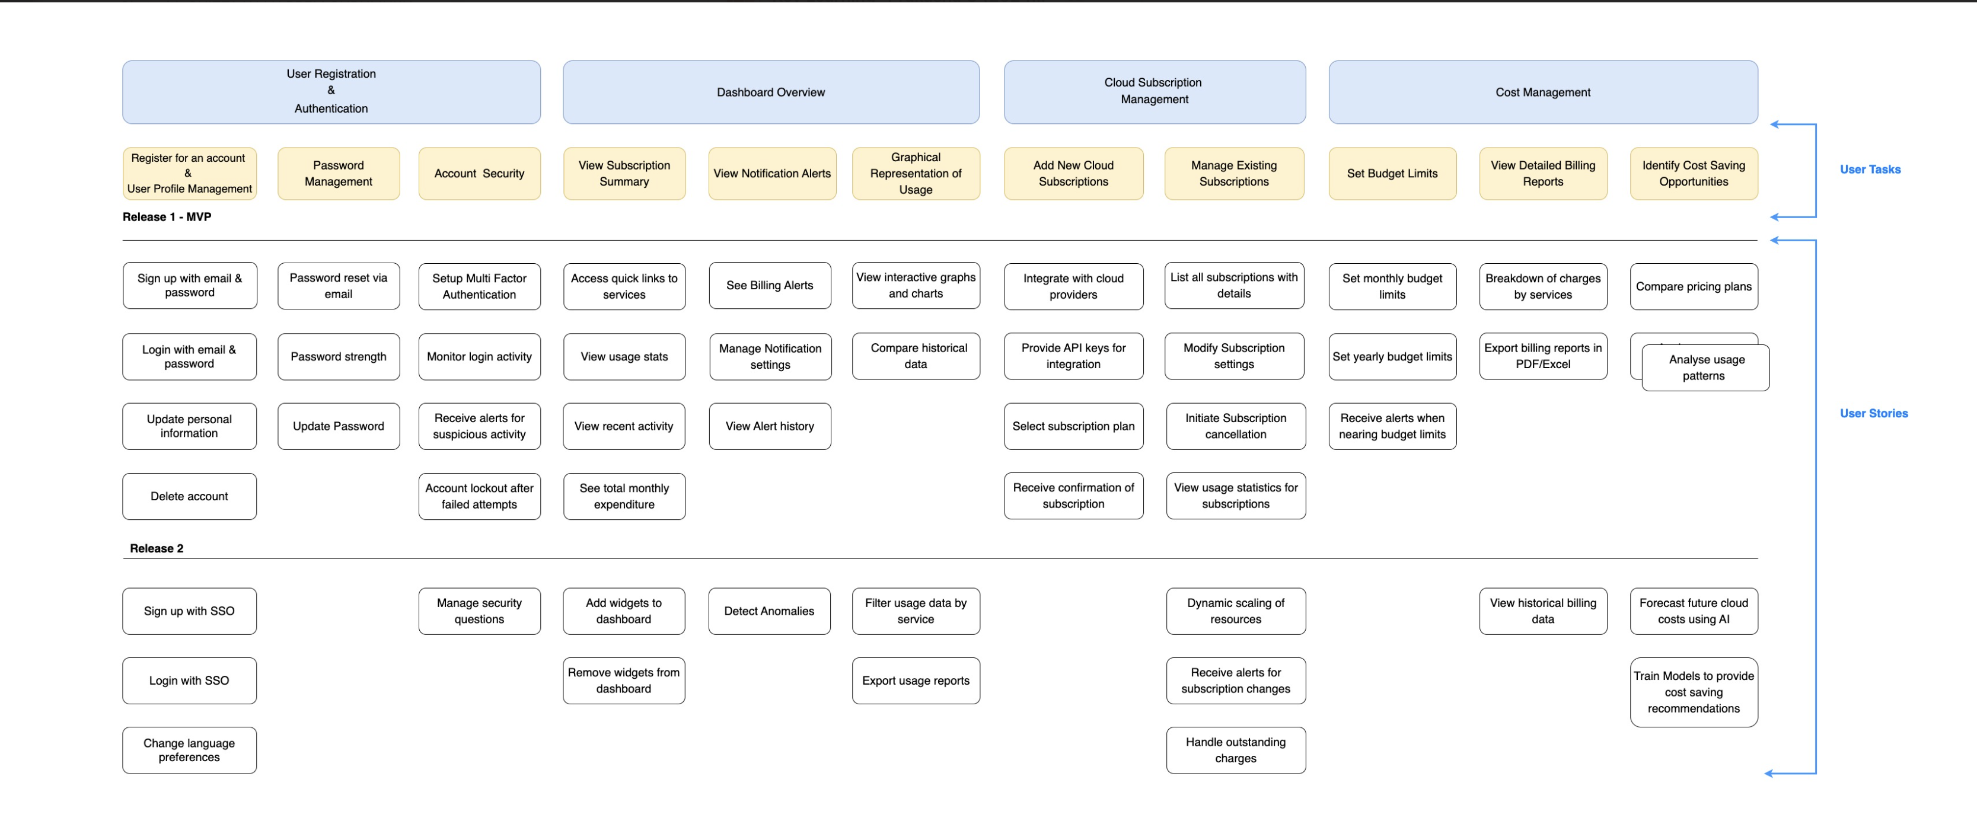
Story Map
Assignment 1 - Summary

Slide 8
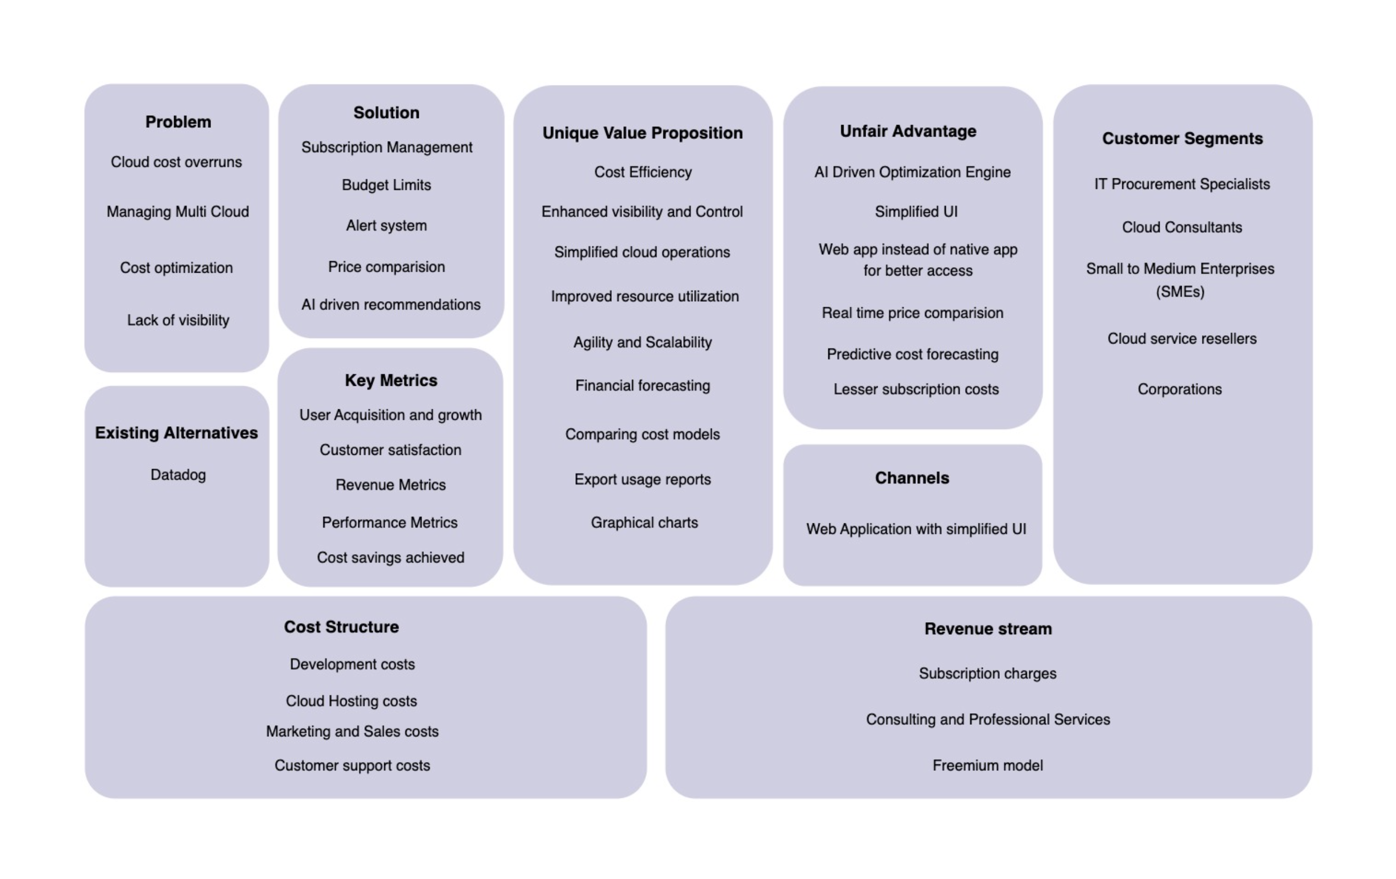
Lean Canvas Start-up
Assignment 1 - Summary

Slide 9
MVP Features & It’s Needs
Automatic Resource Management: The use of AI to allocate and deallocate cloud resources based on real-time usage data as well as historical trends, with real-time historical data.
Centralized Multi-Cloud Subscription Management: An integrated dashboard designed to handle multiple cloud subscriptions across platforms (e.g., AWS, Azure, Google Cloud).
Real-Time Cost Monitoring and Alerts: Monitoring of costs on a continuous basis and the detection of anomalies to alert users to inappropriate spending patterns.
AI-Driven Cost Optimization Recommendations: We offer suggestions for optimizing cloud spend in various aspects, including identifying unused resources and finding cheaper alternatives.
Budgeting and Forecasting Tools: An AI-based approach to forecasting future cloud expenses based on data collected in the past can be used to inform better budgeting for future projects.

Slide 10
MVP Features & It’s Needs
Role-Based Access Control: The implementation of role-specific permissions across cloud resources will enhance data security and governance.
Cost Comparison Across Cloud Providers: In order to make better decisions, users can compare the costs between different cloud providers (e.g., AWS and Azure) for the purpose of making better decisions.
Automated Cloud Cost Alerts and Notifications: Automated alerts can be set up to notify you when your budget reaches certain thresholds or usage spikes rise, so you don't overspend.
Detailed Reporting: For better decision making, comprehensive reports on resource utilization, cost metrics, and underutilization are provided.
Customizable Dashboards and Reports: Users can personalize their dashboard layout and reports to focus on metrics most relevant to their specific needs.

Slide 11
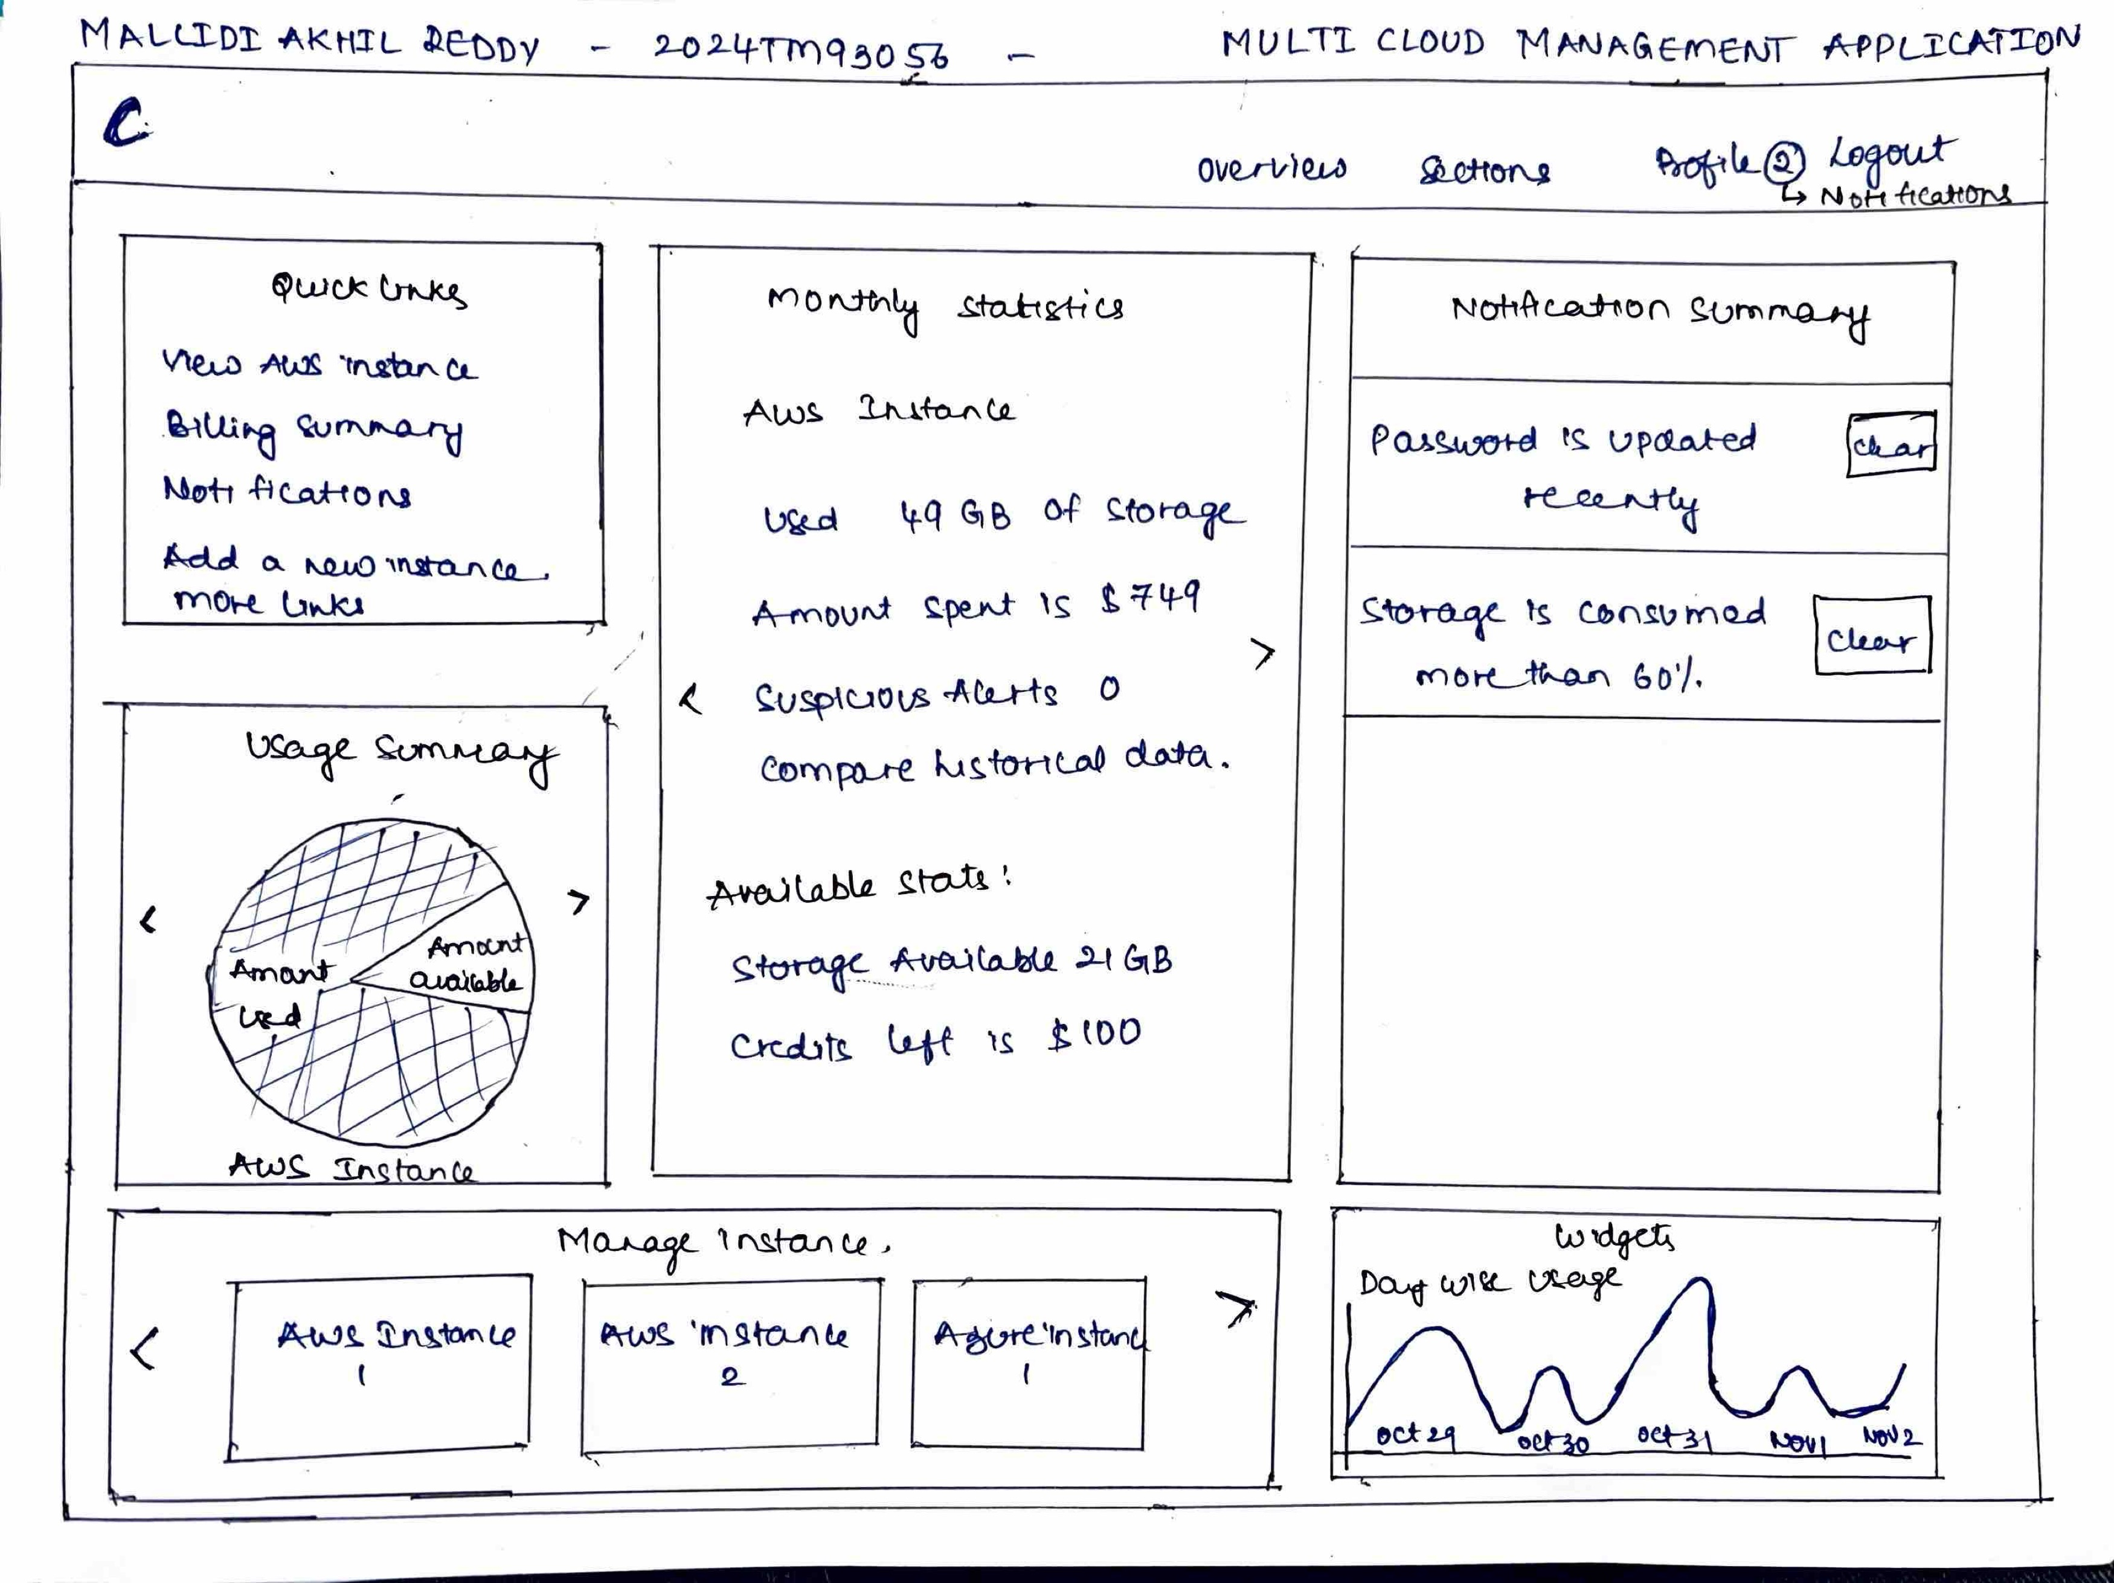
HAND DRAWN SKETCHES BY TEAM

Slide 12
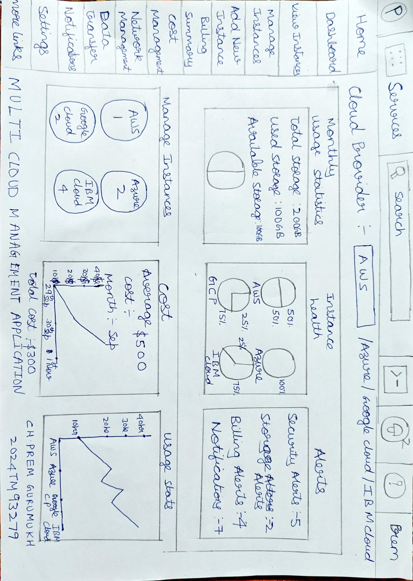
HAND DRAWN SKETCHES BY TEAM

Slide 13
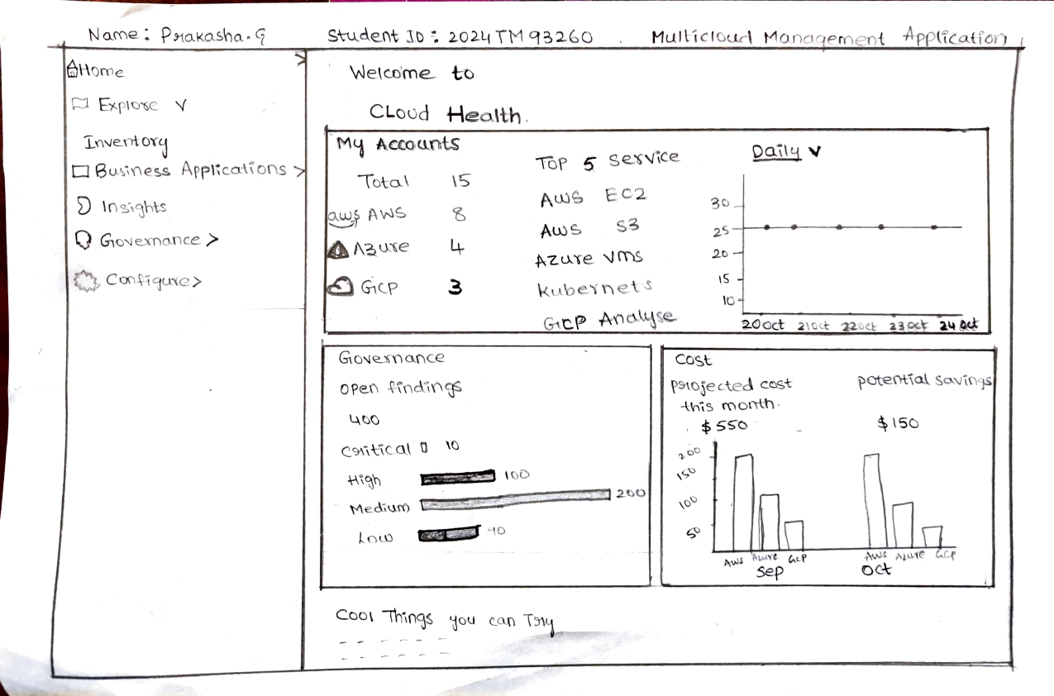
HAND DRAWN SKETCHES BY TEAM

Slide 14
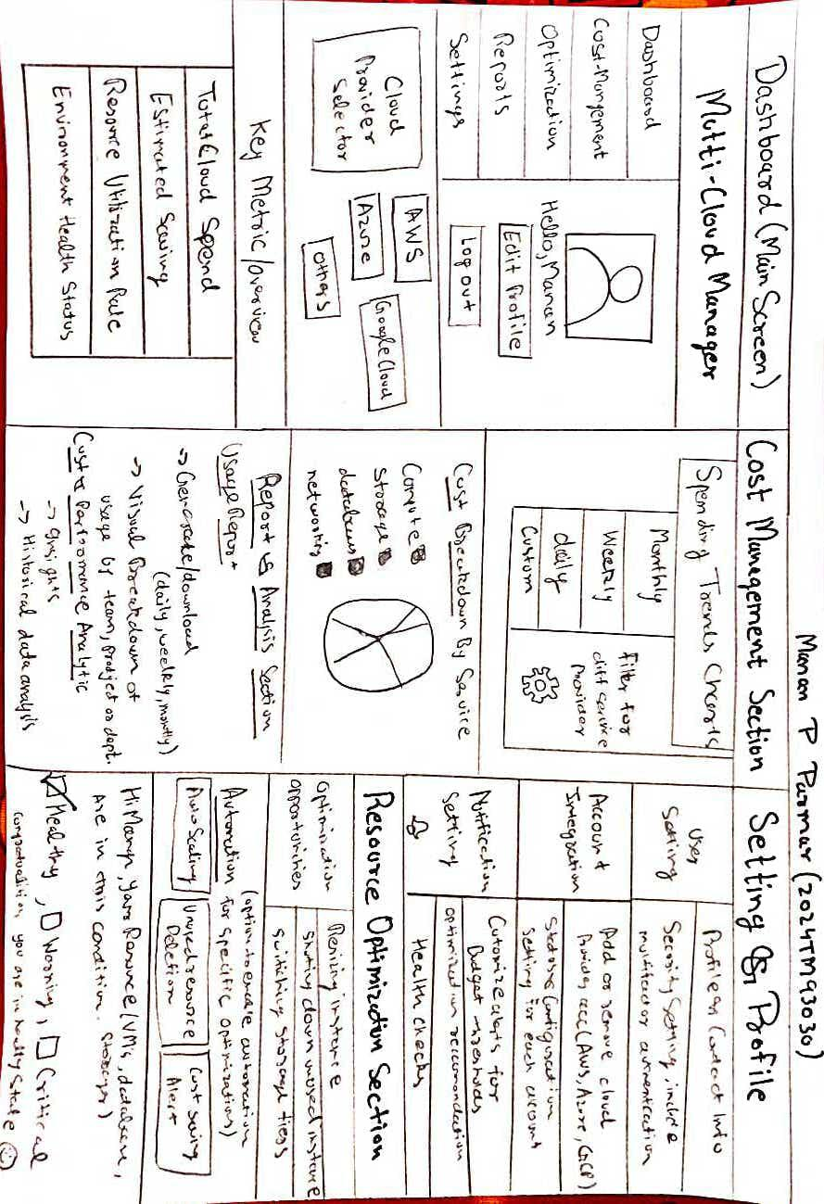
HAND DRAWN SKETCHES BY TEAM

Slide 15
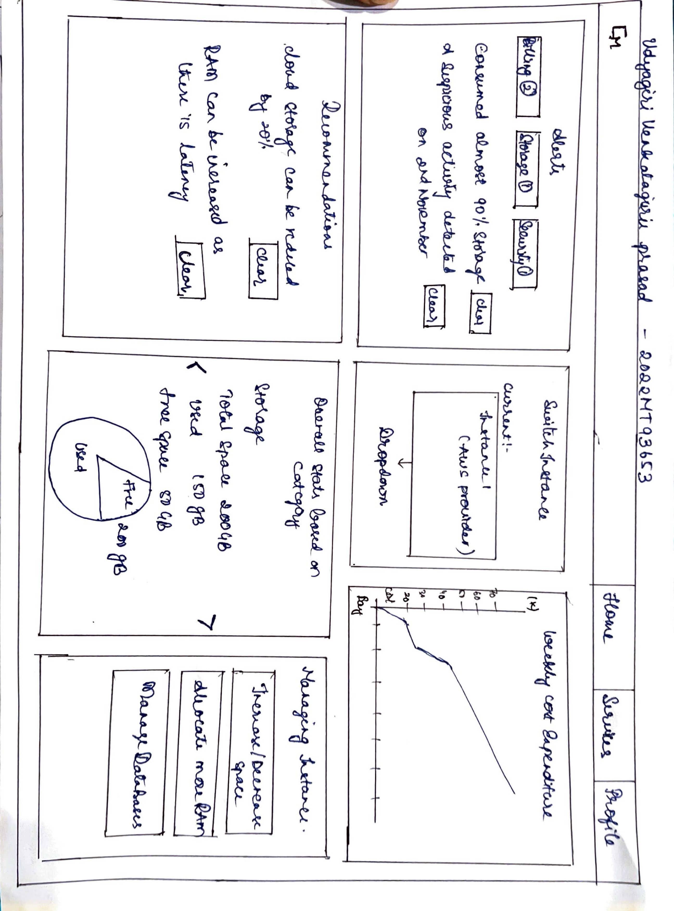
HAND DRAWN SKETCHES BY TEAM

Slide 16
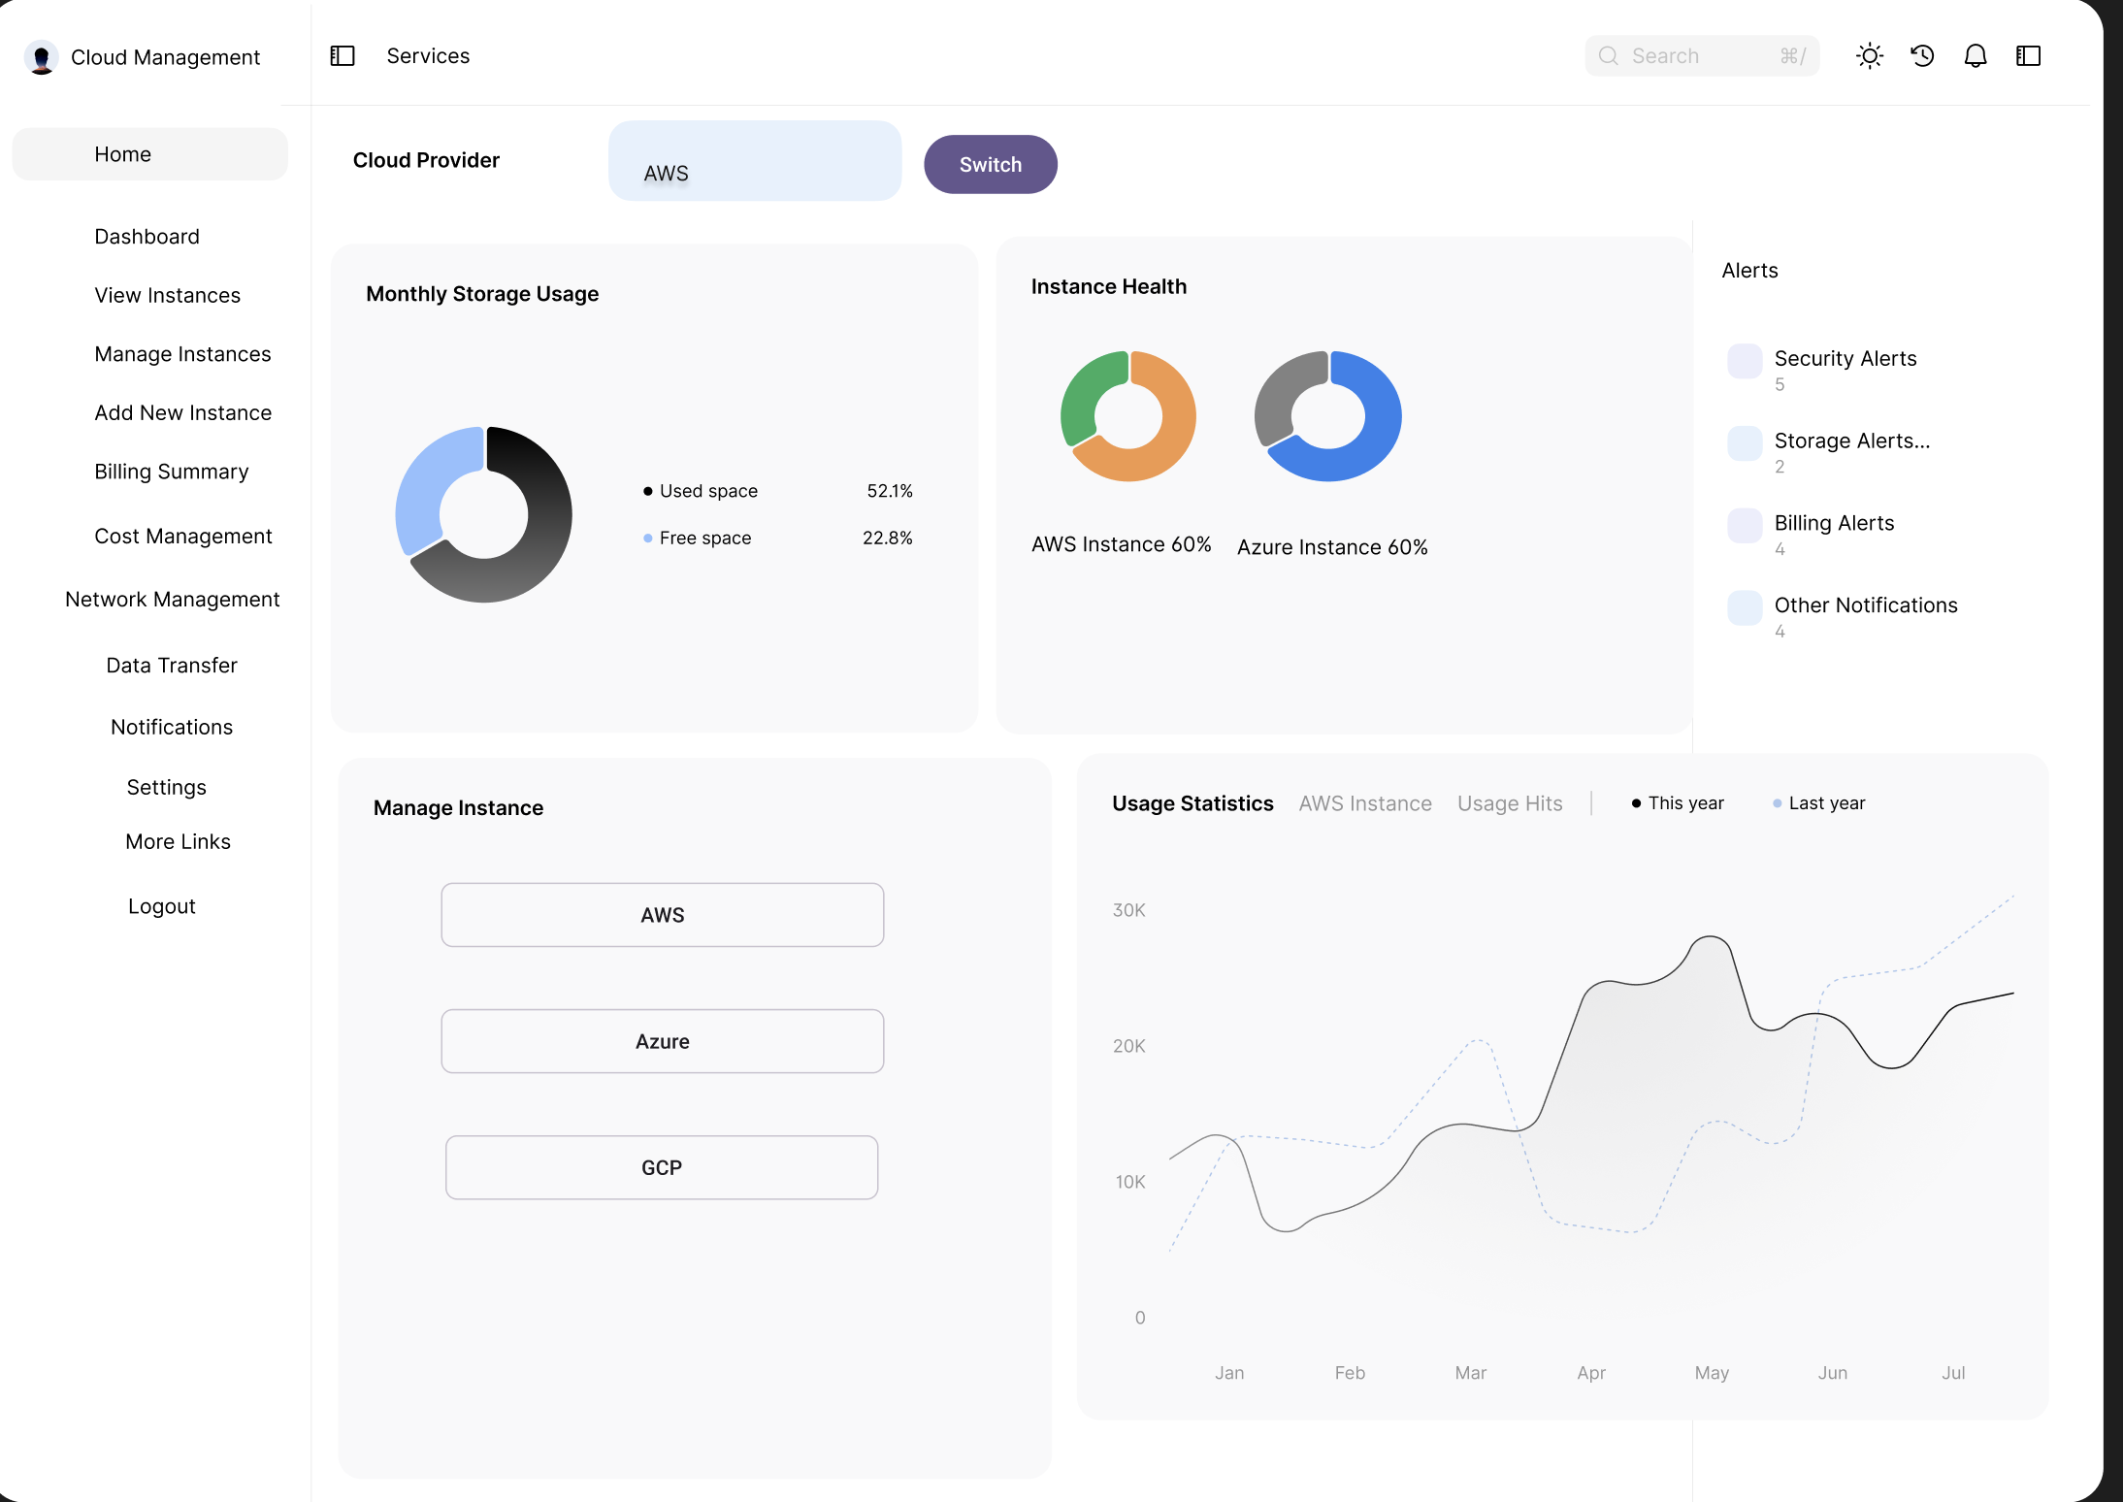
Wireframe Story BOARD

Slide 17
Customer Feedback
Customer 1:
I really like the user interface and design of the app. It's very clean and looks easy use. The app includes the usage time of various applications and tracks the time. But, I would expect dashboard to contain projected cost and potential savings.
Customer 2:
The real-time usage summary is a very valuable feature for understanding how resources effectively utilized their time. It's also helpful in detecting usage patterns, and the inclusion of such a feature will make this app extremely useful for orchestration.

Slide 18
Customer Feedback
Customer 3:
The wireframe looks clean. The features provided will also help in understanding how resources are loaded. The AI intelligence for potential saving will be helpful.
Customer 4:
The app’s real-time cost monitoring feature has been a game-changer for us. It’s great to see potential cost savings immediately, which helps us stay on top of our budget without much manual tracking.

Slide 19
Customer Feedback
Customer 5:
The centralized dashboard is very intuitive. Being able to manage multiple cloud subscriptions in one place saves a lot of time, and the AI-driven recommendations have already helped us optimize resource usage.
Customer 6:
I appreciate the customization options for reports and dashboards. It’s nice to be able to focus on the specific metrics that matter most to our team. This makes our cost analysis more targeted and effective.

Slide 20
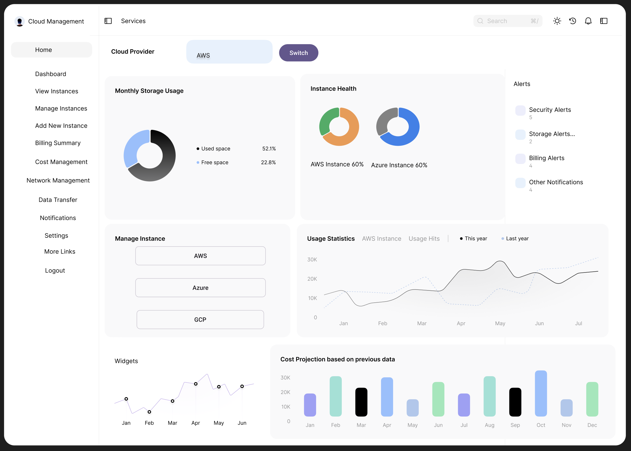
UPDATED Wireframe Story BOARD

Slide 21
Key Learnings – Mallidi Akhil Reddy (2024TM93056)
I gained knowledge about low fidelity wireframes, which offer a fast and effortless approach to depict the arrangement and framework of a product, without getting caught up in the intricacies of design or functionality.
Discovering the significance of receiving customer feedback during the initial phases of product development is crucial in delivering a Minimum Viable Product (MVP).
The significance of a wireframe storyboard lies in its ability to facilitate comprehension of the final product and its features.
Collaborating with a varied team fosters lateral thinking and results in a compelling MVP for the desired product.
The significance of obtaining customer feedback during the design phase of MVP and feature development cannot be overstated.

Slide 22
Key Learnings – Chittajallu Premgurumukh (2024tm93279)
Identifying potential cost-saving features for cloud subscriptions reinforced the importance of strategic resource management, showing me how thoughtful planning can drive impactful decision-making.
Creating wireframes and low-fidelity designs gave me hands-on experience with visualizing ideas quickly. This approach underscored the importance of early testing, which can uncover valuable insights and prevent major design issues before they arise.
Working with team members from diverse backgrounds showed me the power of combining different perspectives, leading to innovative solutions I wouldn’t have reached on my own.
Through real-time feedback, I learned the value of iterating on our product continuously. By adapting to user needs early on, we ensured a more refined and relevant final product.
Prioritizing essential features for the MVP taught me how to effectively manage development tasks, finding the right balance between core functionality and user expectations.

Slide 23
Key Learning- Prakasha G (2024TM93260)
Collaboration: Working in a team to develop solutions for a problem can provide different perspectives and ideas, leading to better outcomes.
Creativity: Low-fidelity hand-drawn sketches can be a valuable tool for brainstorming and generating ideas quickly and effectively.
Prioritization: Identifying and prioritizing the most important features of a product based on the needs of the users and the goals of the project is essential for developing an effective MVP.
User-Centered Design: Developing a product that prioritizes the needs and experiences of the users is key to ensuring its success.
Agile Development: Focusing on developing a minimum viable product (MVP) that can be iterated upon and improved over time is a valuable approach for developing software products.

Slide 24
Key Learnings – Manan Parmar(2024TM93030)
Value of Early Customer Feedback: Gathering user feedback in the initial stages is essential. It helps ensure that the product aligns with real user needs, especially for shaping the MVP and prioritizing important features.
Low-Fidelity Wireframes for Quick Planning: Using simple wireframes allows us to outline the product structure and layout without focusing on details, making it easier to iterate based on feedback.
Effective Team Collaboration: Working with a diverse team encourages new ideas and perspectives, which significantly improves the overall product design and helps us create a more impactful MVP.
User-Centered Design: Focusing on what users need and want leads to a product that is more likely to succeed and be well-received. This approach ensures that the final product is both functional and valuable.
Agile Development for Continuous Improvement: Adopting an Agile approach allows us to develop, test, and refine the MVP continuously, making sure we can adapt quickly to feedback and improve the product over time.

Slide 25
Key learnings – Udyagiri VenkatagurU Prasad (2022MT93653)
Got understanding of how to clearly define a business plan, what problems does the business solve, identification of the target market for the business and the unique value proposition that makes our business sustainable and stand out.
Identifying and prioritizing the most important features of a product based on the needs of the users and the goals of the project is essential for developing an effective MVP.
Competitive landscape as well as market demand analysis helped us define the right set of priorities and thus scope the MVP appropriately.
Discussing designs with customers helped grasp a user perspective which toned our product to be capturing the real world deal breakers and fixing those.

Slide 26
Thank you

